Slide 1
Emotion Detection Using Facial Landmarks
By Alexander Nicholas, Kieran Hawkins, Michael Duggan

Slide 2
Table of Contents
01
Problem Statement
04
Models
Decision Tree
Support Vector Machine
CNN
02
Previous Research
05
Conclusion
Metric Choice
Comparison
Future Goals
Questions
Thank You
03
Data
Dataset Overview
Exploratory Data Analysis
Feature Engineering
Preprocessing and Tuning
Feature Importance

Slide 3
01
Problem Statement

Slide 4
Problem
We aim to develop a lightweight system for classifying facial expressions into seven distinct emotion categories using facial landmarks extracted from images.
This task is important because:
Facial expression recognition plays a critical role in human-computer interaction, security systems, and mental health monitoring.
While deep learning methods dominate this space, they are computationally expensive.
A simpler, fast, and explainable approach is needed, especially for devices with limited computational resources.
Our challenge is to accurately classify human emotions using traditional machine learning models and engineered features from facial landmarks.

Slide 5
02
Previous Research

Slide 6
Prior Research
Our Goals
Facial Expression Recognition with Deep Learning from Stanford
https://cs230.stanford.edu/projects_winter_2020/reports/32610274.pdf
Deep learning models, such as CNN’s trained on FER-2013 (larger facial expression dataset), have shown strong performance but require high computational power.
Landmark-based methods have been explored as a more lightweight alternative but often underperform due to insufficient feature extraction.
Achieve high accuracy with low-complexity models.
Use Optuna and GridSearch to optimize hyperparameters.
Address class imbalance through SMOTE.
Provide clear interpretability of model decisions.
Our Approach
Leverage MediaPipe Face Mesh to extract high-precision facial landmarks.
Engineer geometric features, such as distances and angles, to capture critical facial structures linked to emotions.
We applied three traditional classifiers: Decision Tree, Support Vector Machine (SVM), and a Multi-Layer Perceptron (MLP).
Prior Research and Goals

Slide 7
03
Data

Slide 8
Name
Extended Cohn-Kanade (CK+)
Description
The CK+ dataset contains 593 video sequences from 123 subjects, with peak expression labels.
We used 981 images sampled from these video sequences.
Each sequence depicts a facial expression evolving from neutral to peak expression.
Classes:
  Anger
  Contempt
  Disgust
  Fear
  Happiness
  Sadness
  Surprise
Inputs
Peak frame images processed with MediaPipe Face Mesh to extract 468 facial landmarks.
Engineered features: distances (e.g., mouth corners, eye centers), angles (e.g., eyebrow tilt), and geometric ratios.
Outputs
One of the seven emotion labels.
Dataset Overview

Slide 9
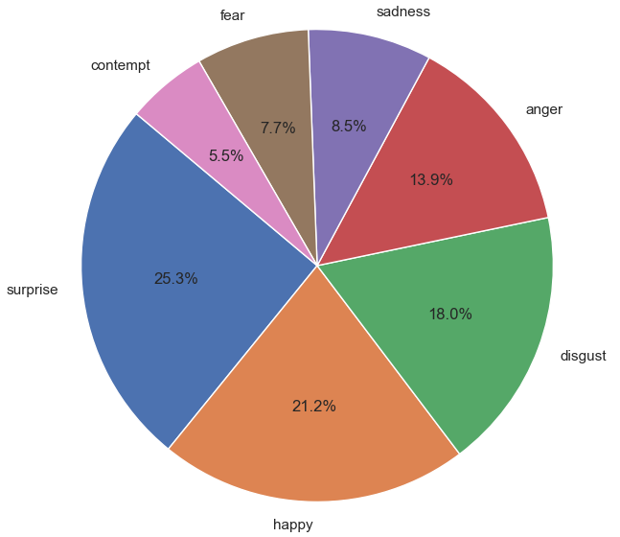
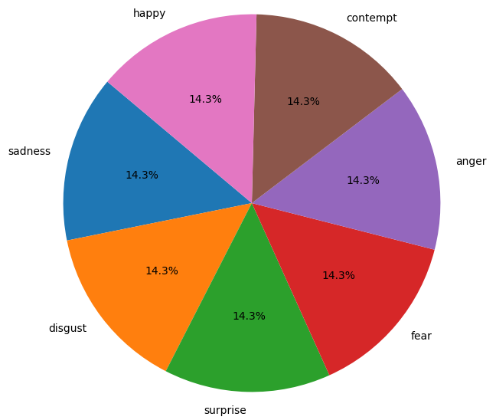
Data Distribution
Training Data Before SMOTE
Training Data After SMOTE
The dataset is imbalanced, with Surprise and Happiness being the most common emotions.
We use SMOTE to synthetically balance the minority classes in the training set.

Slide 10
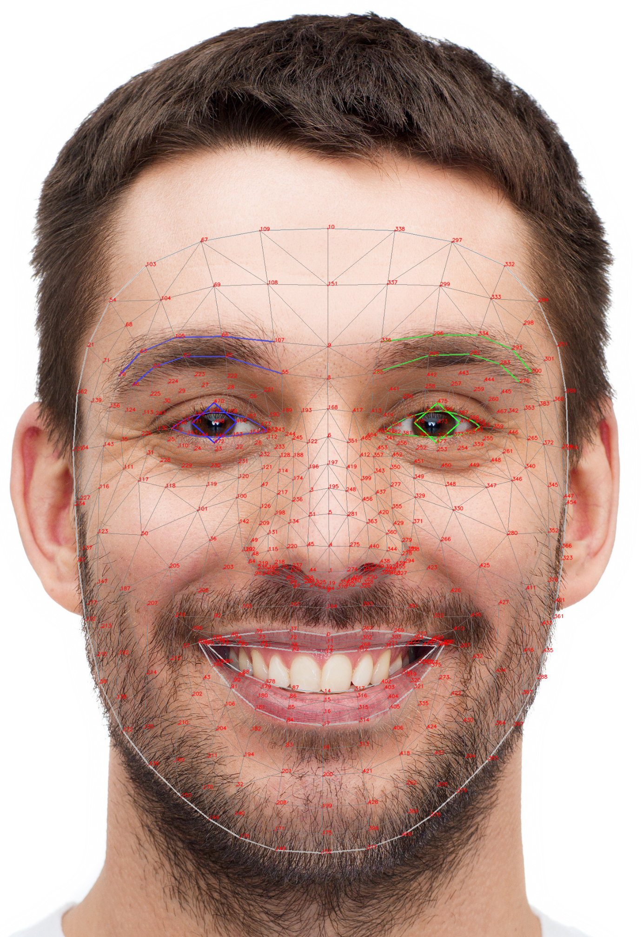
Feature Engineering
Landmark Extraction:
  MediaPipe Face Mesh provides 468 (x, y) coordinates per image.
Engineered Features:
  Distances:
    Mouth width (distance between mouth corners)
    Eye openness (distance between upper and lower eyelid)
  Angles:
    Eyebrow slant (angle between eyebrow points)
    Lip curvature (angle between lip points)
  Ratios:
    Mouth width to face width
    Eye distance to face height

Slide 11
Hyperparameter Tuning
Decision Tree
Support Vector Machine
Multilayer Perceptron (MLP)
Tuned Hyperparameters using GridSearchCV:
  Max depth = 6
  Random state = 1
GridSearchCV
Kernels
  poly (polynomial): C, degree, gamma, coef0
  rbf: C and gamma.
Parameter ranges
  C: [10, 50, 100, 200, 500].
  gamma: [‘scale’, 0.0001, 0.001, 0.01].
Best Parameters:
  C: 50
  gamma: scale
  kernel: rbf
Tuned Hyperparameters using Optuna:
  dropout_p = 0.23061023568800532
  batch_size = 16
  n_layers = 1
  neuron_counts = 16
  lr = 0.0027126928577492
  weight_decay = 0.029172974822711428

Slide 12
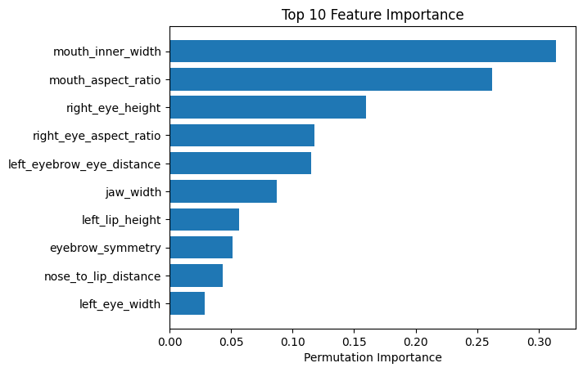
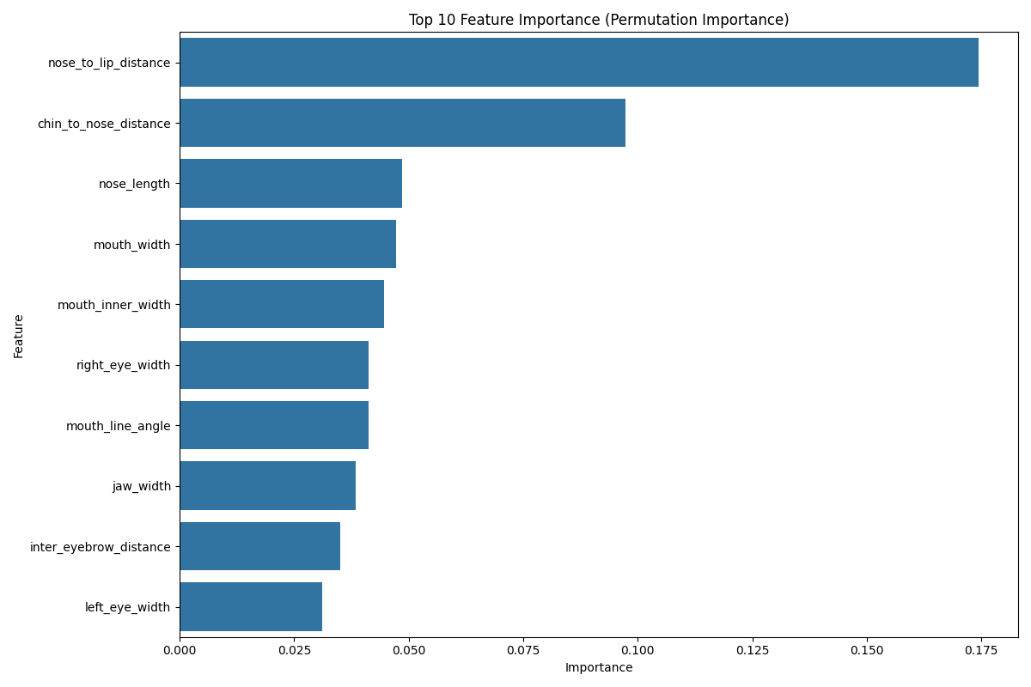
Feature Importance
Decision Tree
Support Vector Machine

Slide 13
04
Models

Slide 14
Decision Trees make it easier to see how decision are made.
Straightforward and Interpretable:
Scaling Not Required:
Decision trees don’t require scaling for data.
Handles Non-linear Relationships:
Decision trees can capture non-linear relationships between features and target variables.
Algorithms Chosen and Why:
Decision Tree

Slide 15
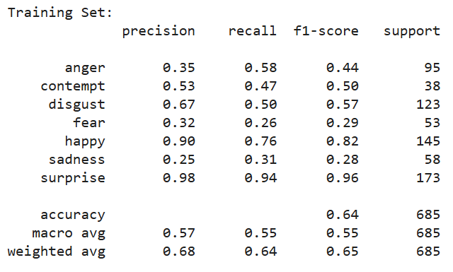
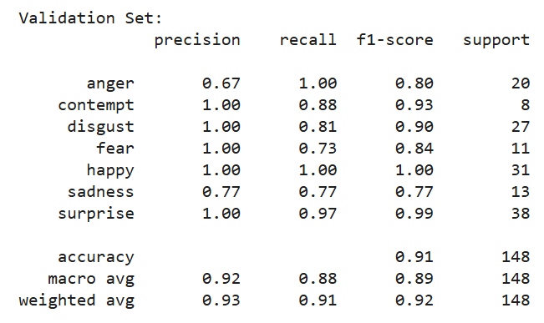
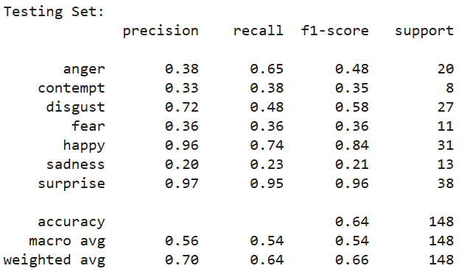
Comparison for Classification Report
Decision Tree
Training
Validation
Testing

Slide 16
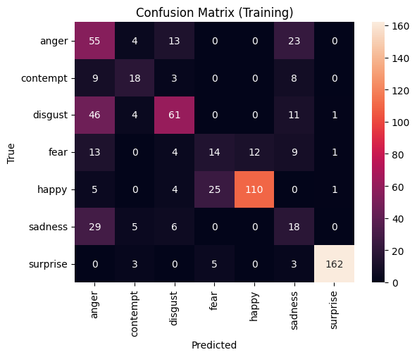
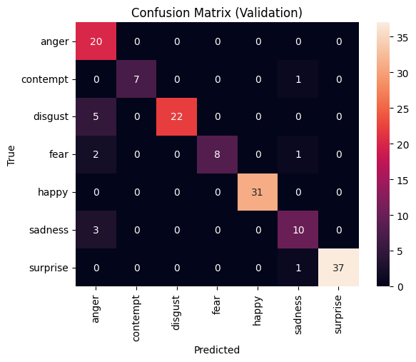
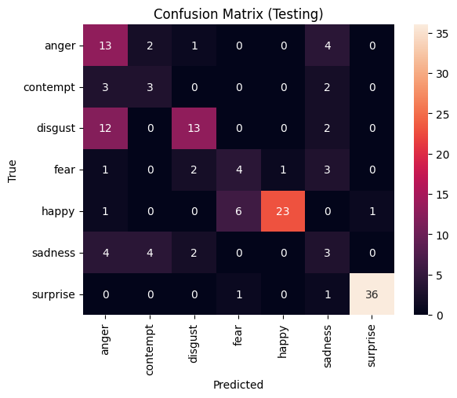
Comparison for Confusion Matrix
Decision Tree
Training
Validation
Testing

Slide 17
Strong Performance in High Dimensions:
SVMs handle high-dimensional feature spaces effectively, making them ideal for our dataset of engineered geometric features (e.g., distances and angles from facial landmarks).
Robust to Overfitting with Proper Tuning:
By using kernel tricks and regularization (C parameter), SVMs can balance the trade-off between model complexity and generalization, reducing overfitting even on smaller datasets like CK+.
Versatile with Non-Linear Kernels:
SVMs support various kernels (e.g., polynomial, RBF) that enable them to capture non-linear decision boundaries—critical for distinguishing subtle differences between similar facial expressions.
Algorithms Chosen and Why:
Support Vector Machine

Slide 18
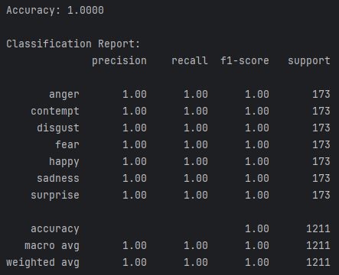
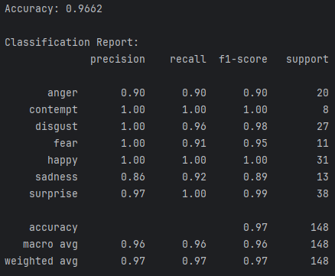
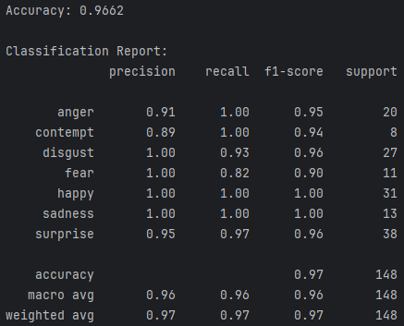
Comparison for Classification Report
Support Vector Machine
Training
Validation
Testing

Slide 19
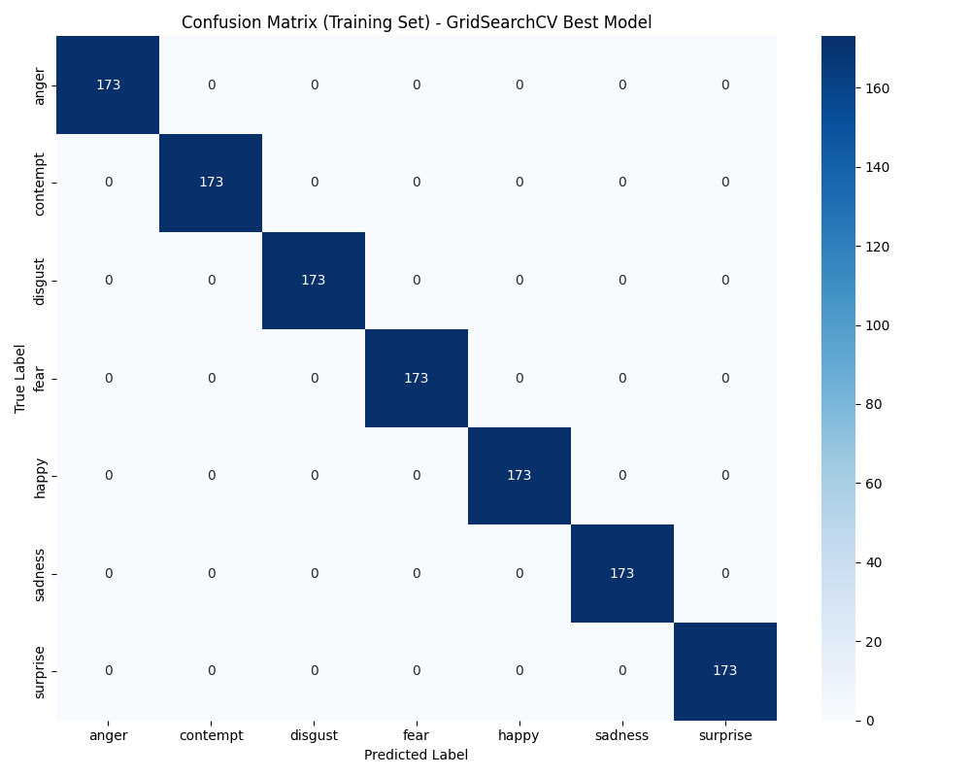
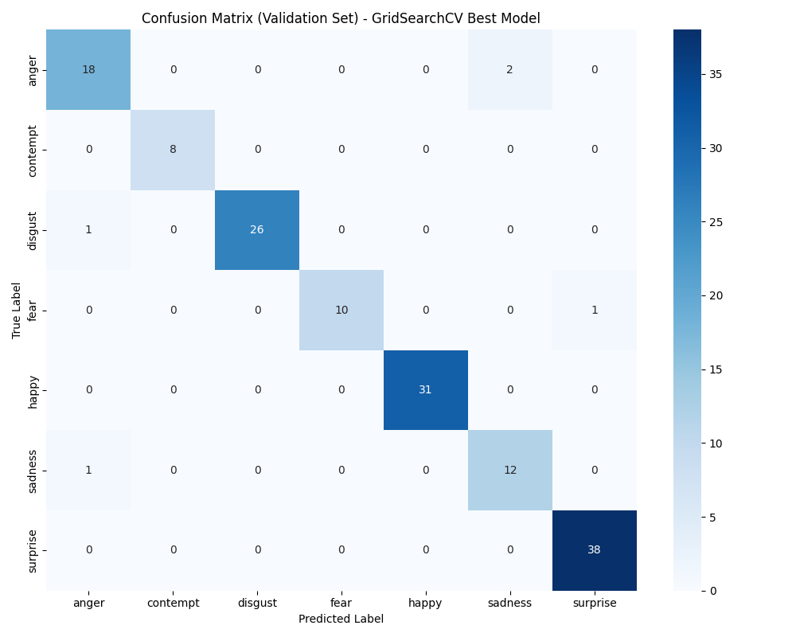

Comparison for Confusion Matrix
Support Vector Machine
Training
Validation
Testing

Slide 20
Effective for Nonlinear Data:
Facial emotions involve complex interactions between landmarks that may not be linearly separable.
Effective for High-Dimensional Data:
MLPs can efficiently learn nonlinear relationships in high-dimensional spaces.
Versatile:
MLP’s have proven to generalize well to small and large datasets.
Algorithms Chosen and Why:
Multilayer Perceptron

Slide 21
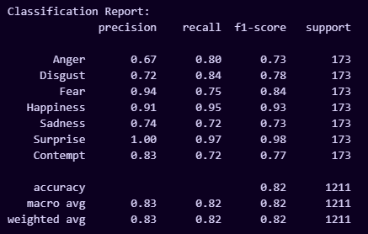
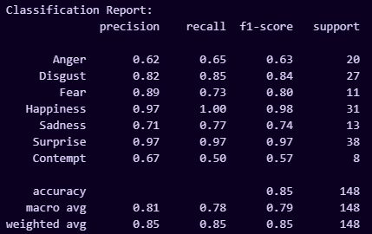
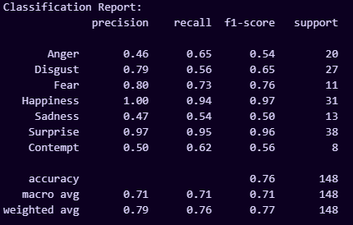
Comparison for Classification Report
Multilayer Perceptron
Training
Validation
Testing

Slide 22
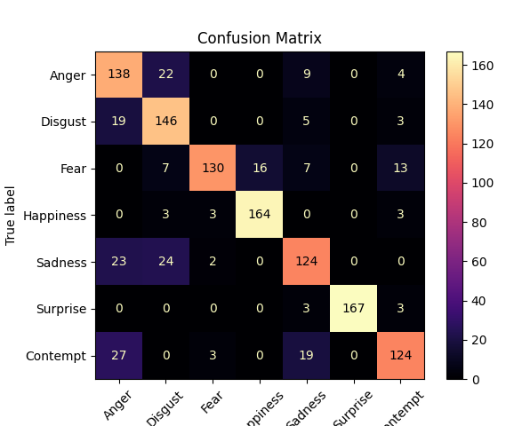
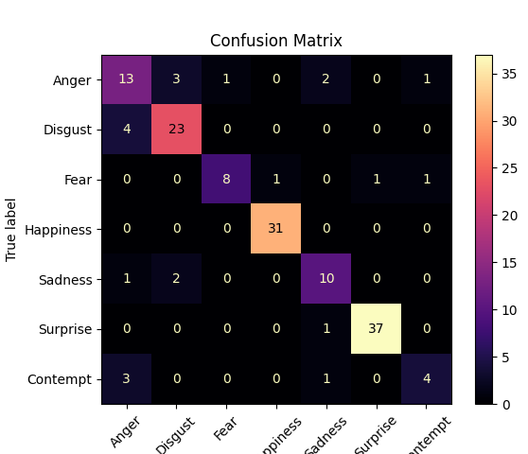
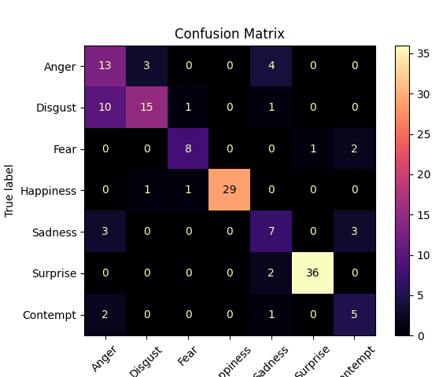
Comparison for Confusion Matrix
Multilayer Perceptron
Training
Validation
Testing

Slide 23
05
Conclusion

Slide 24
Metric To Focus On
Why We Focus on F1 Score Instead of Accuracy
Imbalanced Dataset:
  CK+ dataset has uneven class distribution
  Some emotions like Surprise appear much more frequently than others like Contempt
  A model can achieve high accuracy simply by favoring the majority classes, which gives a false sense of performance.
Balanced Precision and Recall:
  F1 score combines precision (the correctness of positive predictions) and recall (the ability to find all actual positives), offering a more balanced view of performance.
Better Reflection of True Performance:
  Unlike accuracy, which can mask poor results on minority classes, the F1 score highlights weaknesses by penalizing models that fail to detect less common emotions.

Slide 25
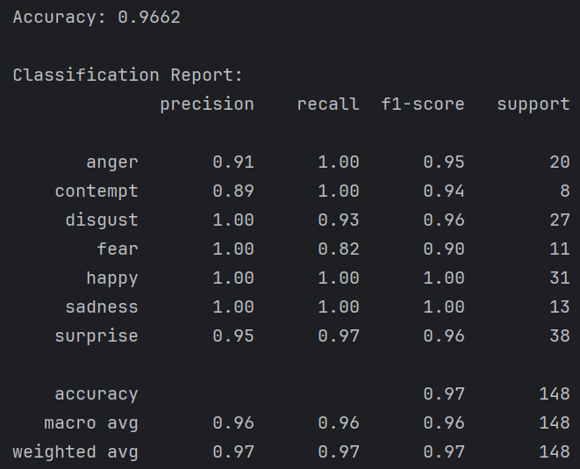

Results
Decision Tree
Support Vector Machine
MLP

Slide 26
Comparison
Future Goals
Interestingly, the SVM actually generalized better to the test set than the more complex MLP.
This may be due to using such a small dataset (less than 700 train images).
The MLP is too complex to effectively learn patterns with this little data.
Smaller models like Decision Trees and SVM’s are less likely to overfit with a dataset of this size.
Try training an MLP on features from a much larger dataset that’s better suited for Deep Learning, like FER-2013.
Compare the performance of an MLP that takes distinct facial features as inputs with a CNN that trains on images of faces directly.
Brainstorm real-world applications of efficient emotion classification using facial landmarks, e.g.:
  Virtual assistants
  Customer Service and Marketing
  Healthcare
  Security and Surveillance
  Entertainment and Media
  In the Workplace
Conclusion

Slide 27
Questions?

Slide 28
THANK YOU

